Slide 1


BANK ANALYSIS
JANUARY 31, 2025
GROUP 2

Slide 2

OBJECTIVES
Larana, Inc.
Identified trends in loan amounts over the years, highlighting periods of growth or decline. Applied statistical techniques to detect patterns and anomalies.
Analyzed revolving balances across different loan grades and subgrades to understand risk exposure. Used data visualization tools like Power BI for clear insights.
Conducted a comparative analysis of total payments between verified and non-verified borrowers, providing key financial insights on borrower reliability.
Mapped loan distributions across states and tracked seasonal borrowing trends, helping in regional and time-based financial decision-making.
Assessed the impact of homeownership on loan repayments using advanced data analytics, improving risk assessment strategies.

Slide 3





TOOLS USED
Larana, Inc.
Excel
Power BI
Tableau
SQL
Mission

Slide 4


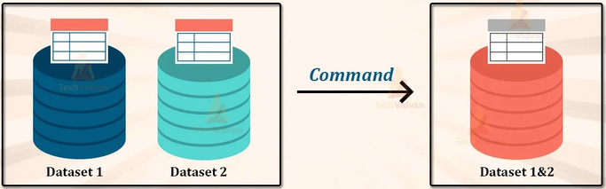

TASKS
Data Cleaning
Merging Data Sets
Our customers are at the heart of everything we do. We listen, respond, and tailor our services to meet their needs.
INTERACTIVE DASHBOARDS
We embrace technological advancements and innovative practices to enhance customer experience and improve our offerings.
Integrity
Innovation
We uphold the highest ethical standards in all interactions, ensuring transparency and accountability.

Slide 5

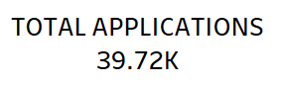
Larana, Inc.
Indicates the total number of loan applications received.
A higher number suggests strong demand for loans.

Slide 6

Larana, Inc.
Represents the total loan payments collected.
This is a key revenue indicator for the bank.

Slide 7
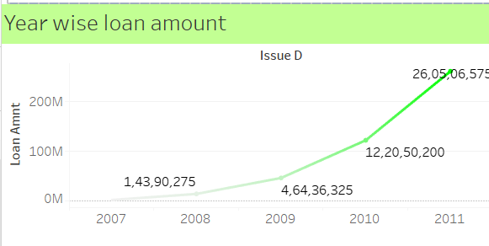
Larana, Inc.
Shows an increasing trend in loan disbursement, with significant growth from 2007 to 2011.
Indicates higher trust in lending services and increased borrower demand.

Slide 8
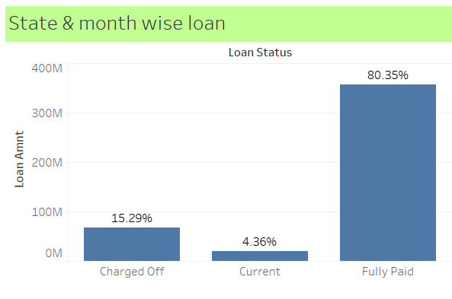
Larana, Inc.
Charged Off (15.29%)
Current (4.36%)
Fully Paid (80.35%)
This represents loans that were defaulted and written off.
These are loans that are still being repaid.
A strong indicator of good repayment behavior.

Slide 9
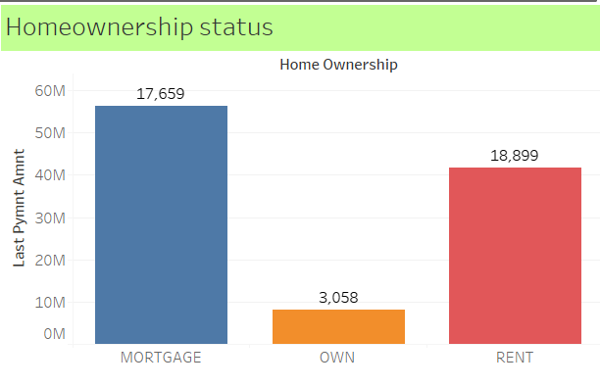
Larana, Inc.
Mortgage Holders (17,659 loans, highest amount disbursed):
Homeowners (3,058 loans)
Renters (18,899 loans, high amount disbursed)
Generally considered lower risk as they have property assets.
Typically riskier since they lack home equity.
Represent a smaller portion.

Slide 10
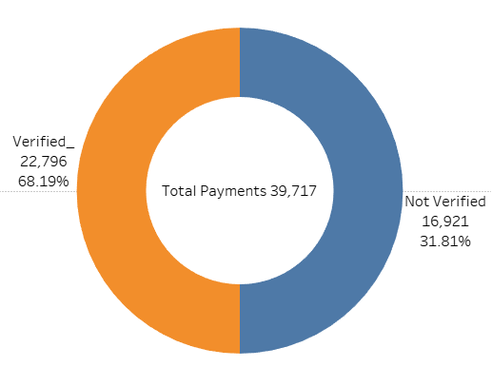
Larana, Inc.
Verified (68.19%)
Not Verified (31.81%)
The majority of loans have undergone verification
A significant percentage of loans were issued without verification, which might pose a risk.

Slide 11
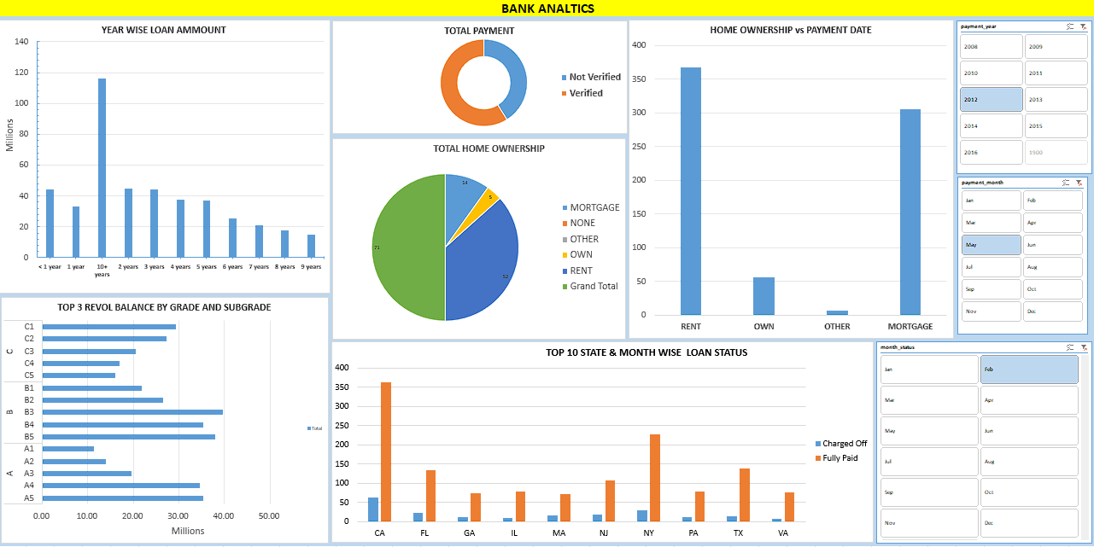
Excel Dashboard
Larana, Inc.

Slide 12
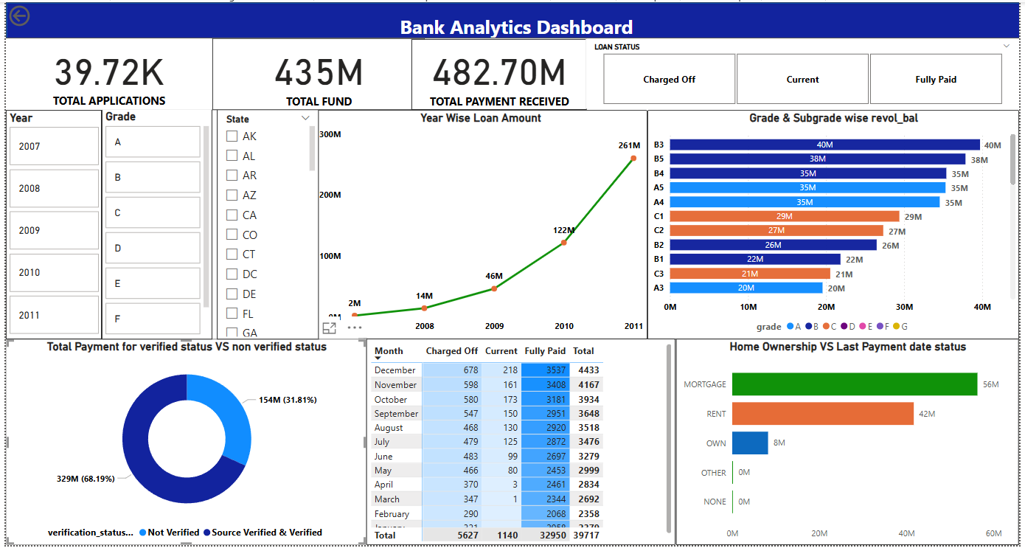
POWER BI
Larana, Inc.

Slide 13
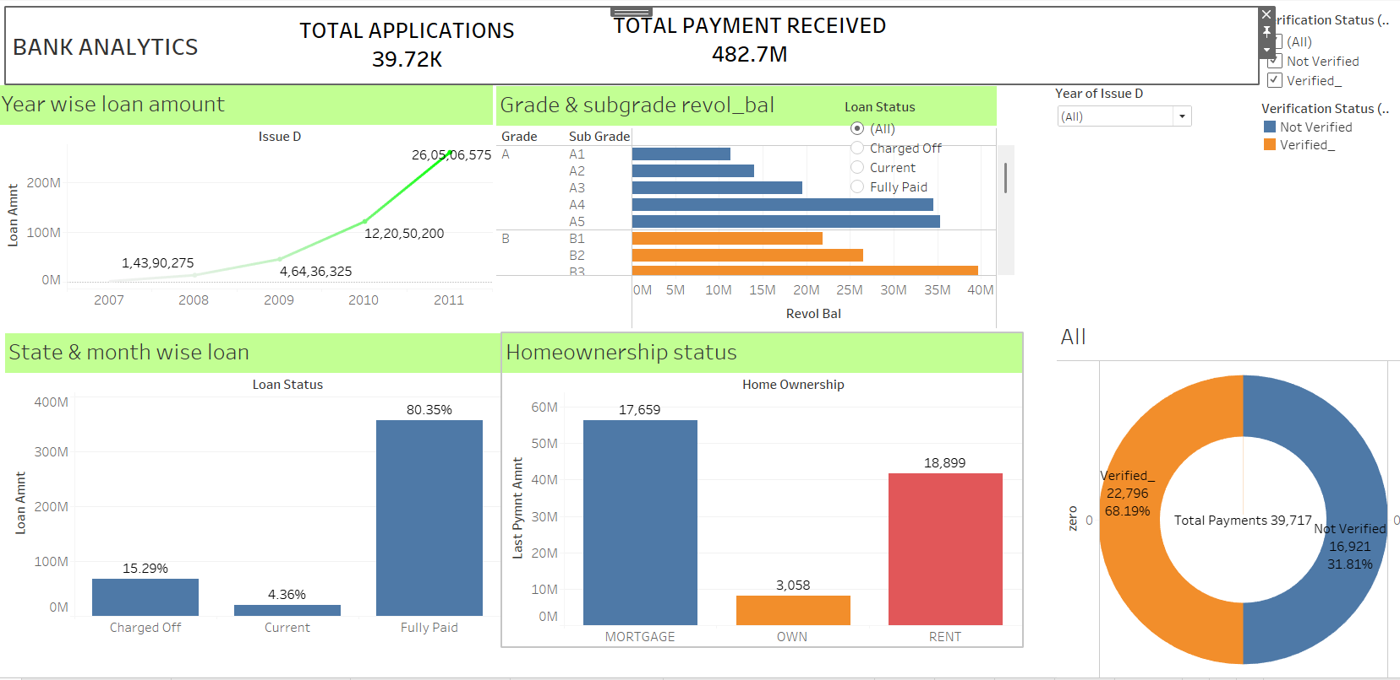
TABLEAU
Larana, Inc.

Slide 14
SQL
Larana, Inc.
Year wise loan amount Stats
2. Grade & Subgrade Revolving Balance
3. Verification Status

Slide 15
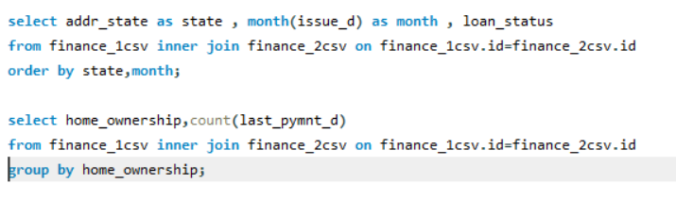
SQL
Larana, Inc.
Loan Status Distribution
Homeownership Status & Loan Performance

Slide 16


Larana, Inc.
INSIGHTS & RECOMMENDATIONS
The increase in loan disbursement suggests business growth but requires monitoring for potential risks.
The high percentage of fully paid loans is positive, but the 15.29% charge-off rate is a concern.
Loans issued to renters should be analyzed further to assess default risks.
Unverified loans (31.81%) need closer scrutiny to ensure risk mitigation.

Slide 17

Group 2
BHASKAR SINGH
GARGI TIWARI
D. Bindu
C NEELIMA
Ijaaz Ismail
BOGUDA DEVENDRANATH
Bangaru Prasad

